Slide 1




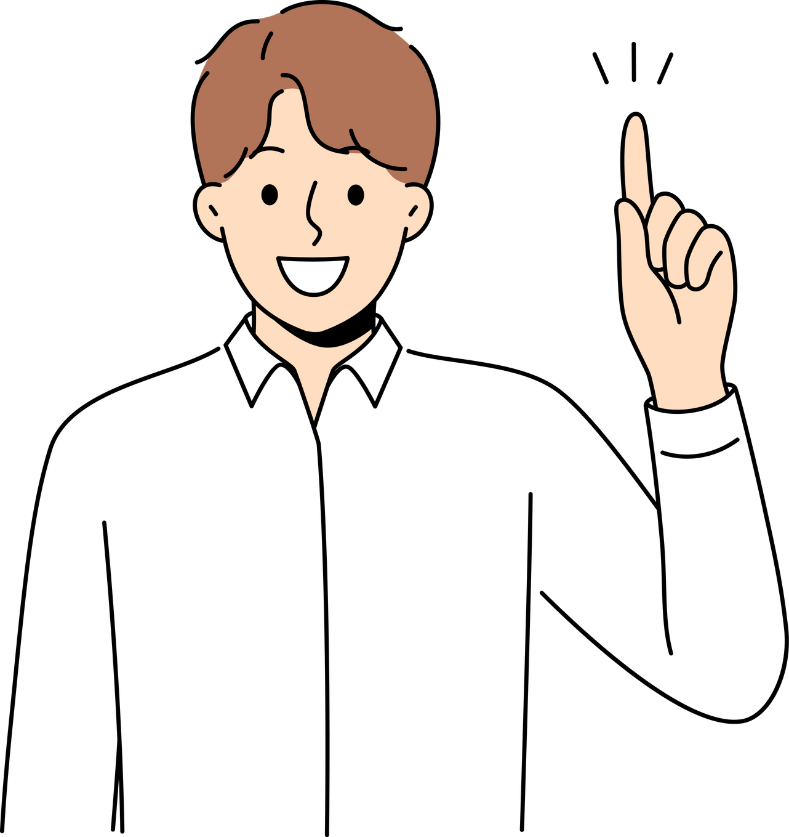
QUERY
QUESTION & ANSWERS WEBSITE

Slide 2

CONTENT
INTRODUCTION & OBJECTIVES
TECH STACK
DFD
MODULES
GLIMPSES OF OUR WEBSITE
SCHEMA DIAGRAM
FUTURE SCOPES
CONCLUSION

Slide 3



OBJECTIVES
Introducing a Query Website:
A query website is a hub for asking questions and receiving answers from a community of experts and enthusiasts. It offers a convenient platform for users to seek information, engage in discussions, and satisfy their curiosity on a wide range of topics. With its user-friendly interface and powerful search capabilities, it serves as a valuable resource for learning and collaboration in today's digital landscape
The objective of Query, a popular question-and-answer platform, is to provide a platform for people to share knowledge, perspectives, and experiences by asking questions and receiving answers from a diverse community of users. Query aims to facilitate the exchange of information on a wide range of topics, fostering discussions and enabling users to learn from each other. Additionally, Query seeks to connect people with similar interests and expertise, creating a global community where individuals can contribute their insights and learn from the collective knowledge of the community.

Slide 4


TECH STACKS
Frontend
Backend
Database
CSS
React js,
Bootstrap,
Javascript,
Firebase Authentication
Nodejs Express
MongoDB Atlas

Slide 5
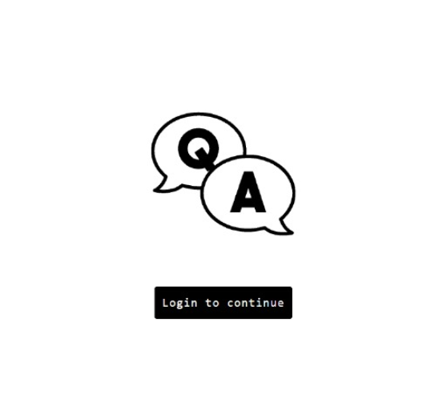
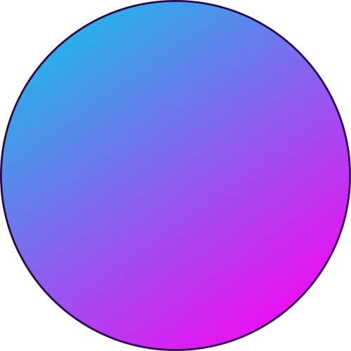
MODULES
A person should be able to
An admin should be able to
Login or logout anytime
Delete any irrelevant content from the feed
Can control logged in profiles
Post any question
Post answer
See any question-answer
Like or dislike any answer
Share any answer externally

Slide 6

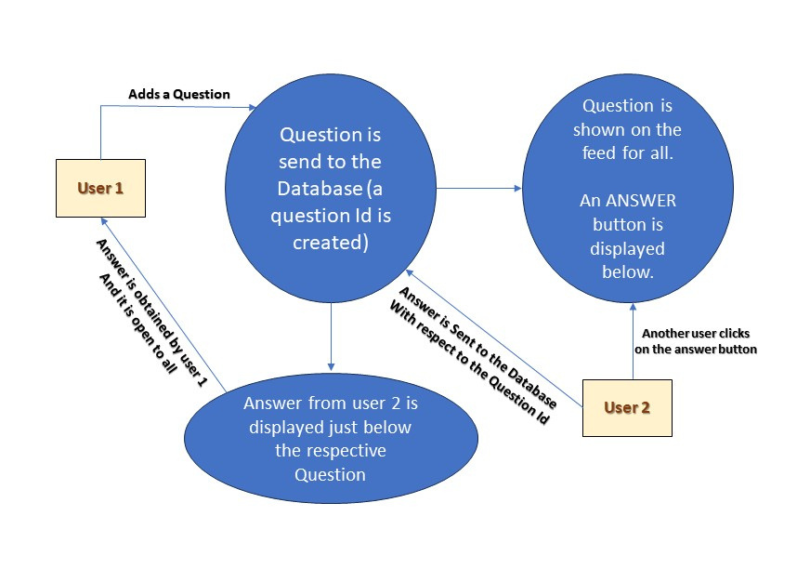
D F D

Slide 7

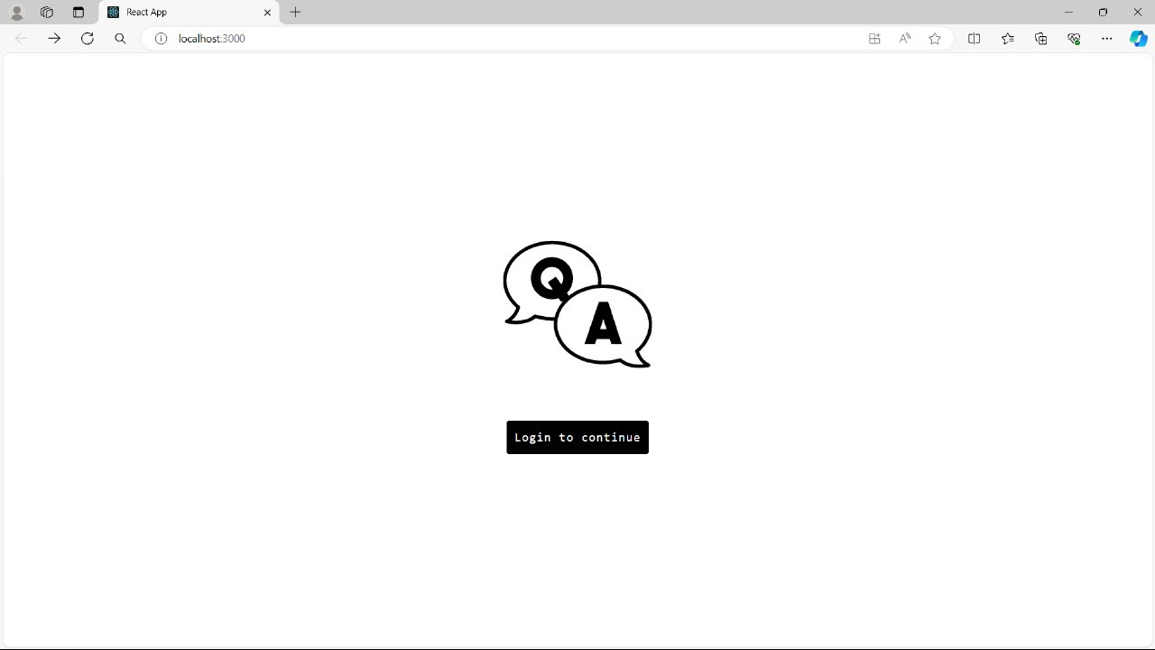

LANDING PAGE
NORMAL
MATERIAL
UI DESIGNS
USING
REACT CSS

Slide 8
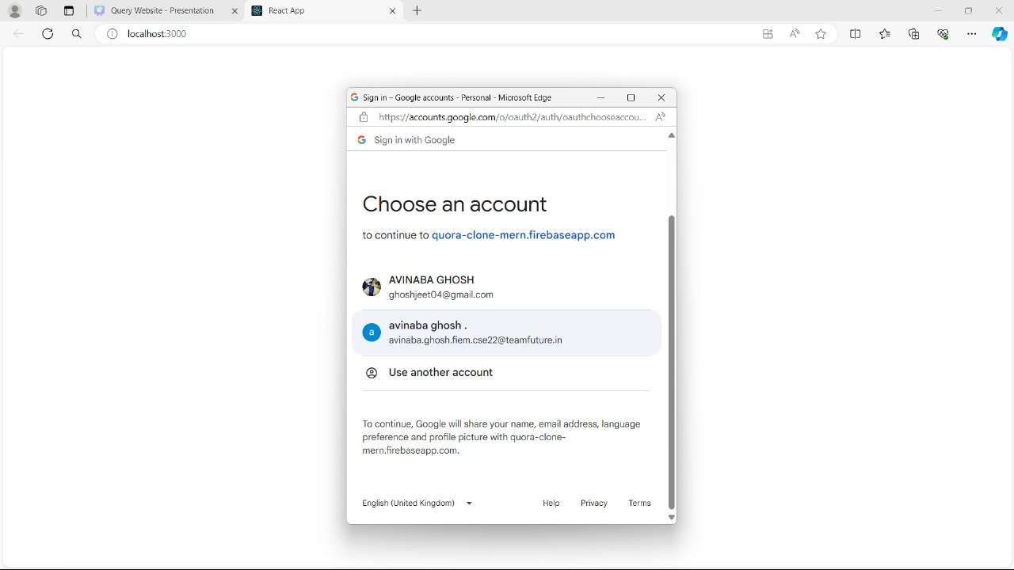


LOGIN AUTHENTICATION
We have used
Firebase Authentication

Slide 9

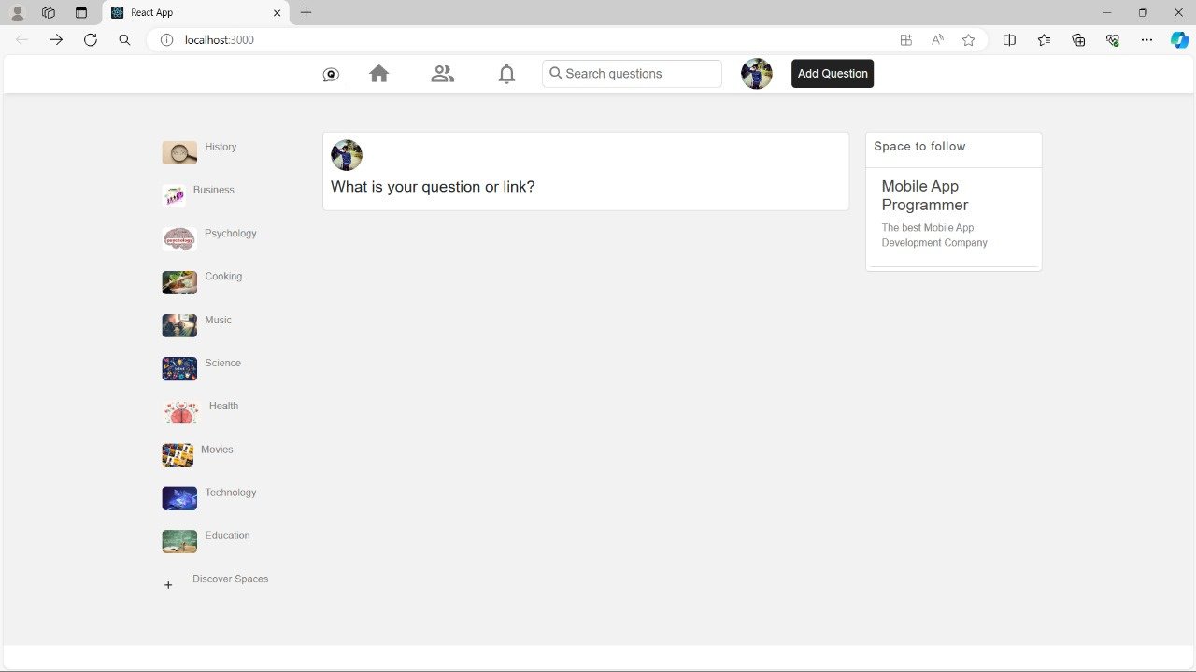

FEED
01

Slide 10

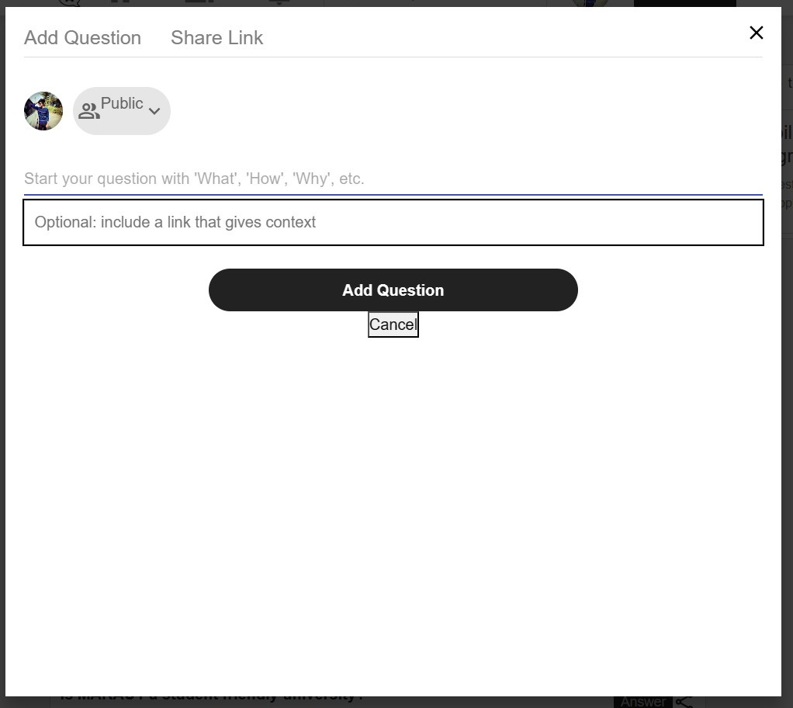
Question Panel
Made using Modals

Slide 11
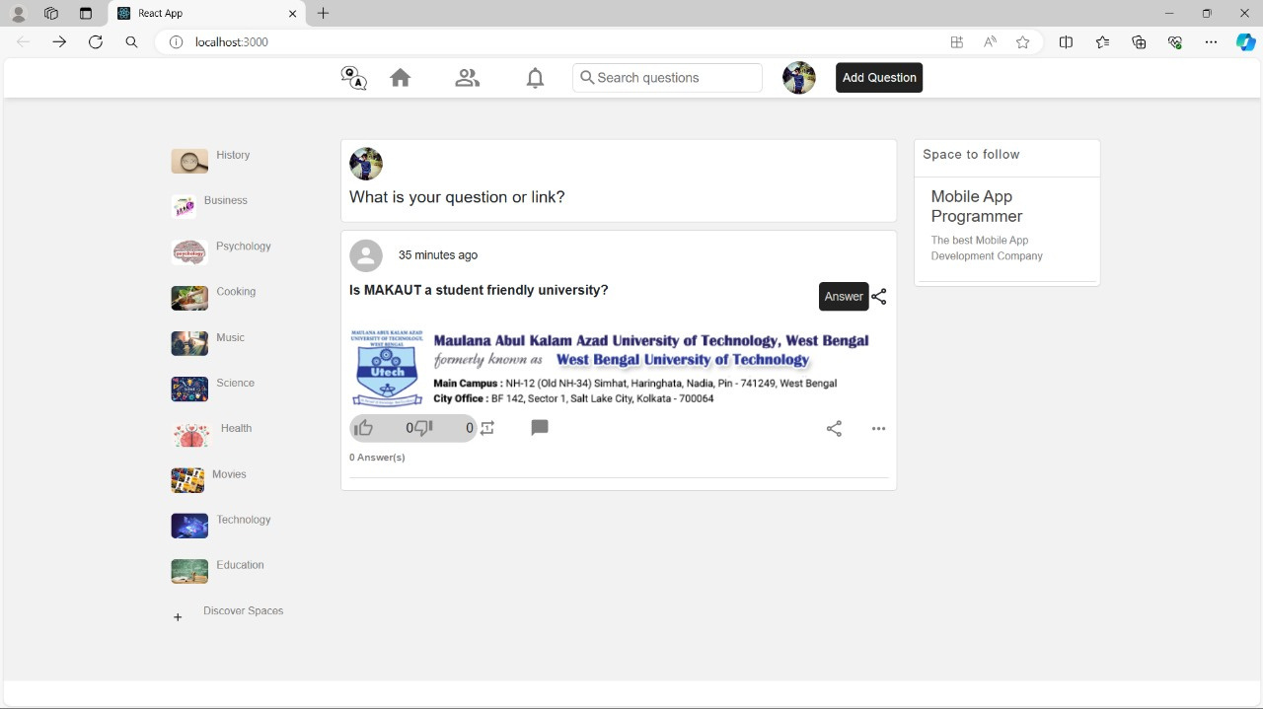

QUESTION ADDED SUCCESSFULLY

Slide 12
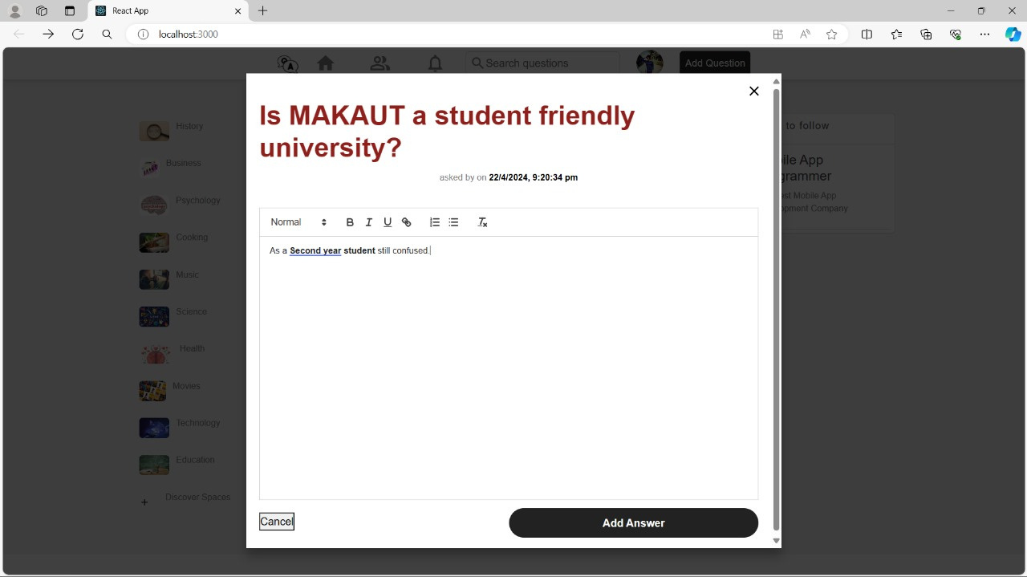
ANSWER DIALOG BOX
USING MODALS

Slide 13
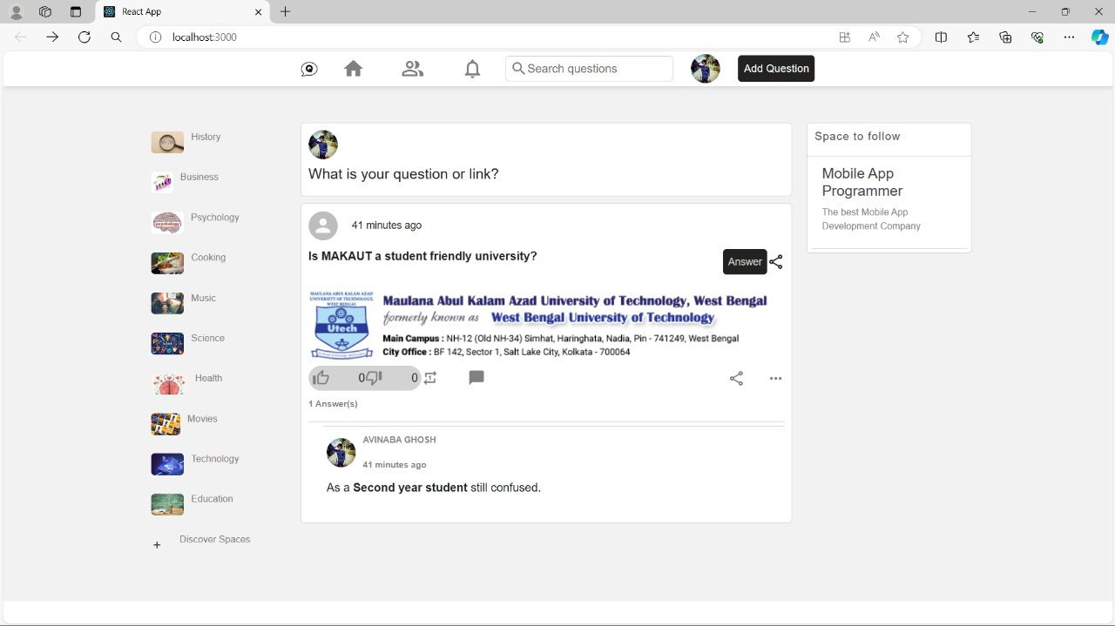
ANSWER ADDED SUCCESSFULLY

Slide 14
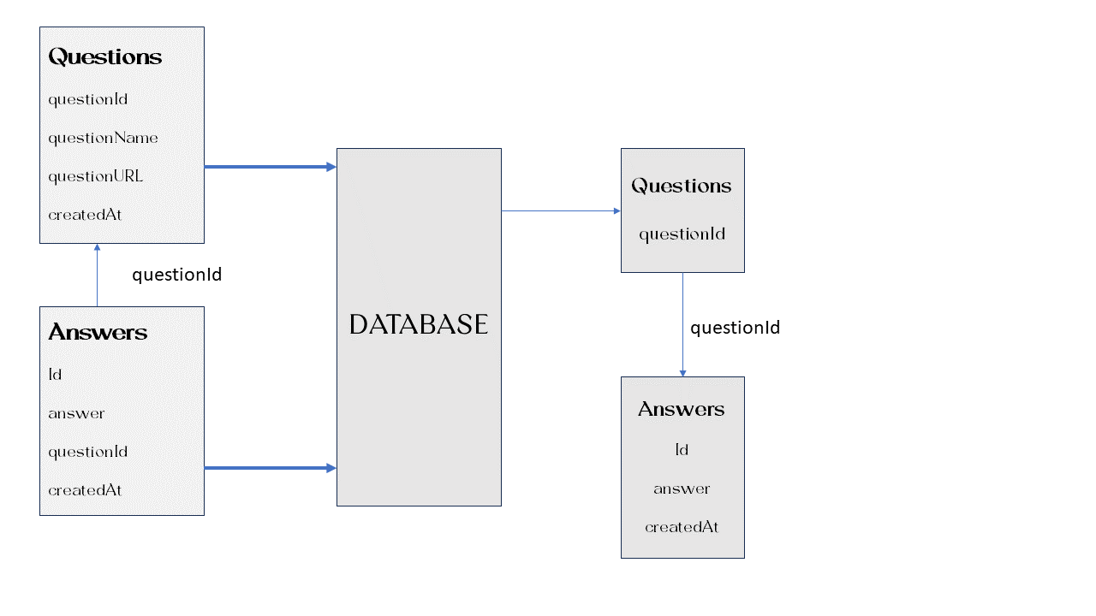
SCHEMA DIAGRAM
DEPICTING HOW THE APIs ARE WORKING AND CONNECTING TO THE DAABASE

Slide 15
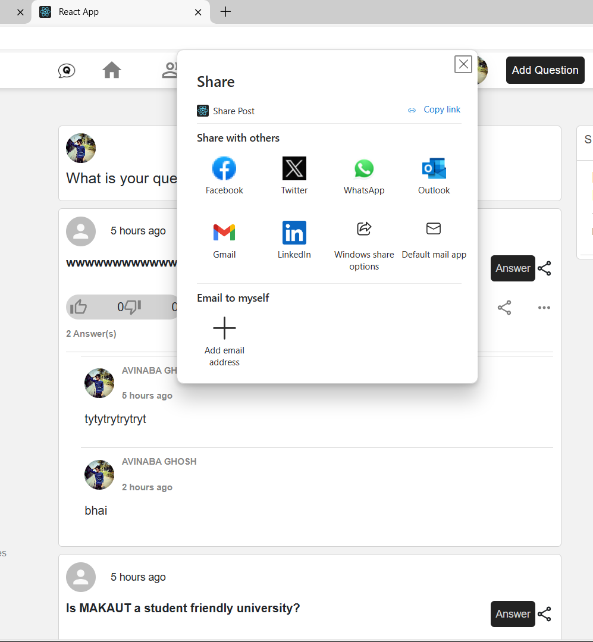

SHARE POST
Using Web
Share API
(navigator.share)

Slide 16
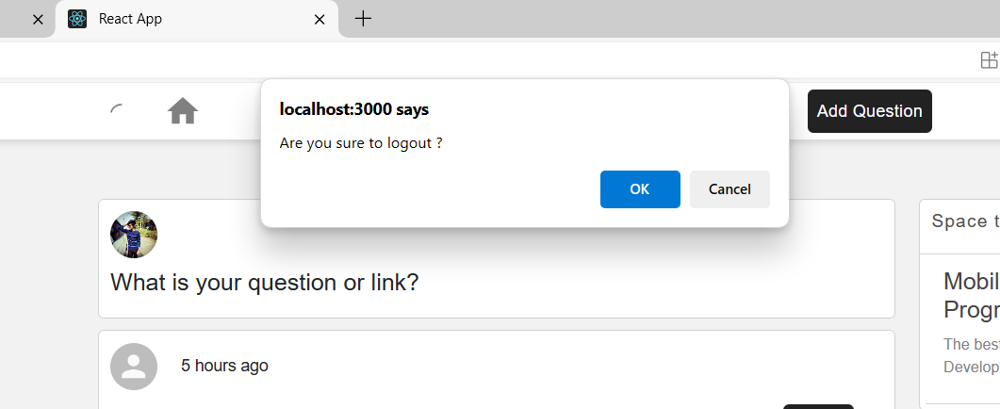
LOGGING OUT
FINALLY
GOOD BYE

Slide 17



FUTURE SCOPES
We will add a button which when clicked will ....show the peoples who are online and can share contents inter.
2.
People can have personalised search under the
spaces such that the questions will get automatically added under the specific topics.
3.
After developing it further day by day making it a platform for the communication medium among different colleges.

Slide 18



CONCLUSION
The goal of this thesis was to create an online question-answer social networking website and research the basics of MERN Stack: MongoDB, Express.js framework, React.js library and Node.js platform. The theoretical background section has covered the study of an online question-answer social network concept, also methods and technologies to implement the thesis. This chapter helps us to understand how this thesis project was implemented.

Slide 19

THANK
YOU
Submitted by:-
Avinaba Ghosh
Abhisikta Majumdar
Ishan Majumder
Preyoshi Mondal
Samik Bhattacharya

